Slide 1



1

Slide 2
LEARNING OUTCOMES
By the end of this session, you will be able to:
Review & practice on various grammatical points
Reinvest idioms in speaking
Review the structure of an argumentative essay
2

Slide 3
OUTLINE
01
02
03
04
Tenses to describe charts/trends
3rd & Mixed Conditionals
Relative Clauses
Passive & Active Voices to describe processes
05
06
08
07
Direct & Indirect Questions
Future Perfect
Writing
Idioms
3

Slide 4

Tenses
Tenses indicate the time of occurrence. We use simple and perfect tenses to describe charts and trends.
4

Slide 5

Guess the Form and give examples
Past simple
Verb + -ed / -d / -ied
studied
illustrated
died
Present simple
Verb + -s / -es / -ies
tries
stands
goes
Future simple
Will + verb infinitive
will reach
5

Slide 6

Simple Tenses
Past
Present
Future
In 2003, China’s car production increased by 85 %.
China's fiscal revenue plunges 26.1% as virus ravages economy.
In 2022, China’s annual per capita GDP will reach $23 trillion.
We use the simple past to talk about …
We use the simple present to describe …
We use the simple future to talk about …
a movement or trend which happened in the past and is now finished.
current actions / trends or situations.
an action that will begin and end in the future.
6

Slide 7
Signal words
yesterday, 2 minutes ago, in
1990, last Monday …
every Monday, every week,
once, twice, three times a week
normally, often,
seldom, sometimes
in a year, next week, next Tuesday, tomorrow…
Past simple
Present simple
Future simple
7

Slide 8
Guess the Form and give examples
Past Perfect
had + verb past participle
had increased
had risen
Present Perfect
Future Perfect
Have/has + verb past participle
have sold
has given
Will have + past participle
will have done
will have stopped
8

Slide 9
Perfect Tenses
Past Perfect
Present Perfect
Future Perfect
By 2010, the percentage of mobile users had increased by 20 %.
The US economy has grown rapidly over the past four years.
The world population will have reached 8.5 billion by 2030.
Past Perfect
Present perfect
Future perfect
We use the past perfect to describe …
We use the present perfect to talk about …
We use the future perfect to talk about …
a completed action which happened before another action in the past.
a movement or trend which started in the past but is not yet finished.
actions that will be completed or over before another action at a certain time in the future.
9

Slide 10
Signal words
always, never, for, since, before, after, by + past date
since (since August), for (for five years), this month/year or expressions with over (over the past six months)
until, before or by the end of the day/week/month, by + future date.
Past Perfect
Present Perfect
Future Perfect
10

Slide 11
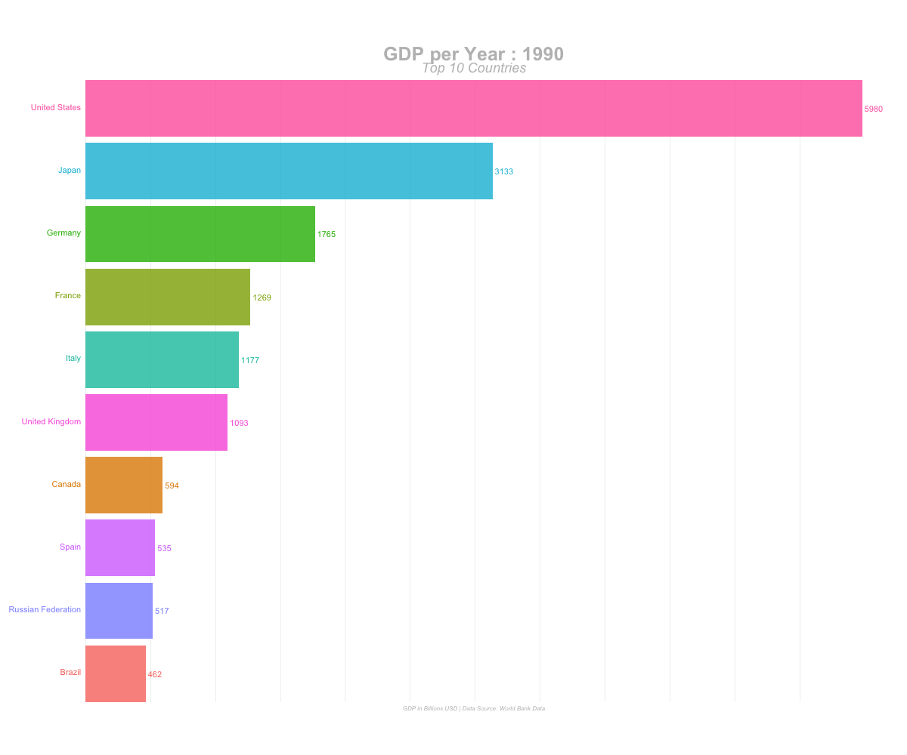
Simple and perfect tenses are used to describe charts
There are two forms of charts
11

Slide 12
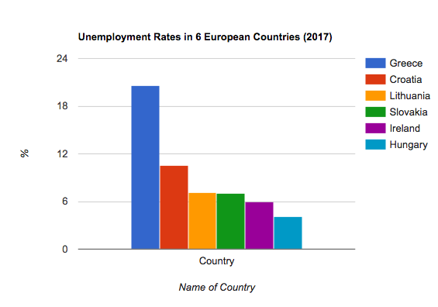
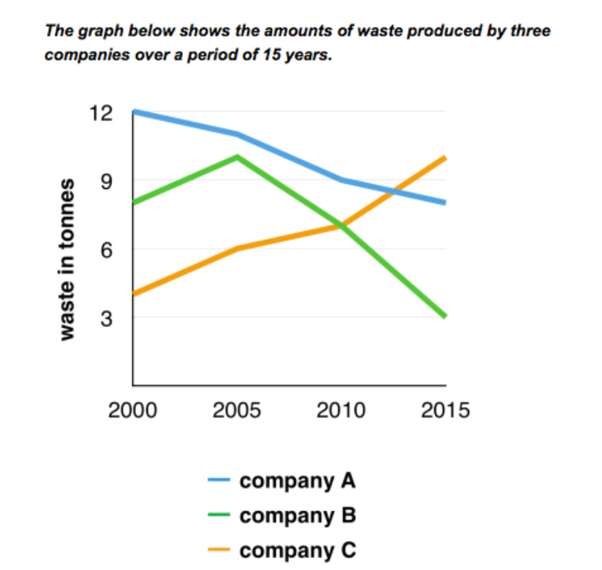
Static chart
One point in time
Simple tenses
Dynamic chart
A change over time
Simple and Perfect tenses
12

Slide 13

Choose the right option
To plunge (v), a plunge (n) means
a) a big decrease b) a decrease c) no change d) an increase
To soar (v)
a) big decrease b) a decrease c) an increase d) a big increase
to level off (v), a levelling-off (n)
a) a big decrease b) no change c) an increase d) a big increase
to drop (v.), a drop (n.)
a) a big decrease b) a decrease c) no change d) an increase
to plummet (v.)
a) big decrease b) a decrease c) no change d) a big increase

Slide 14

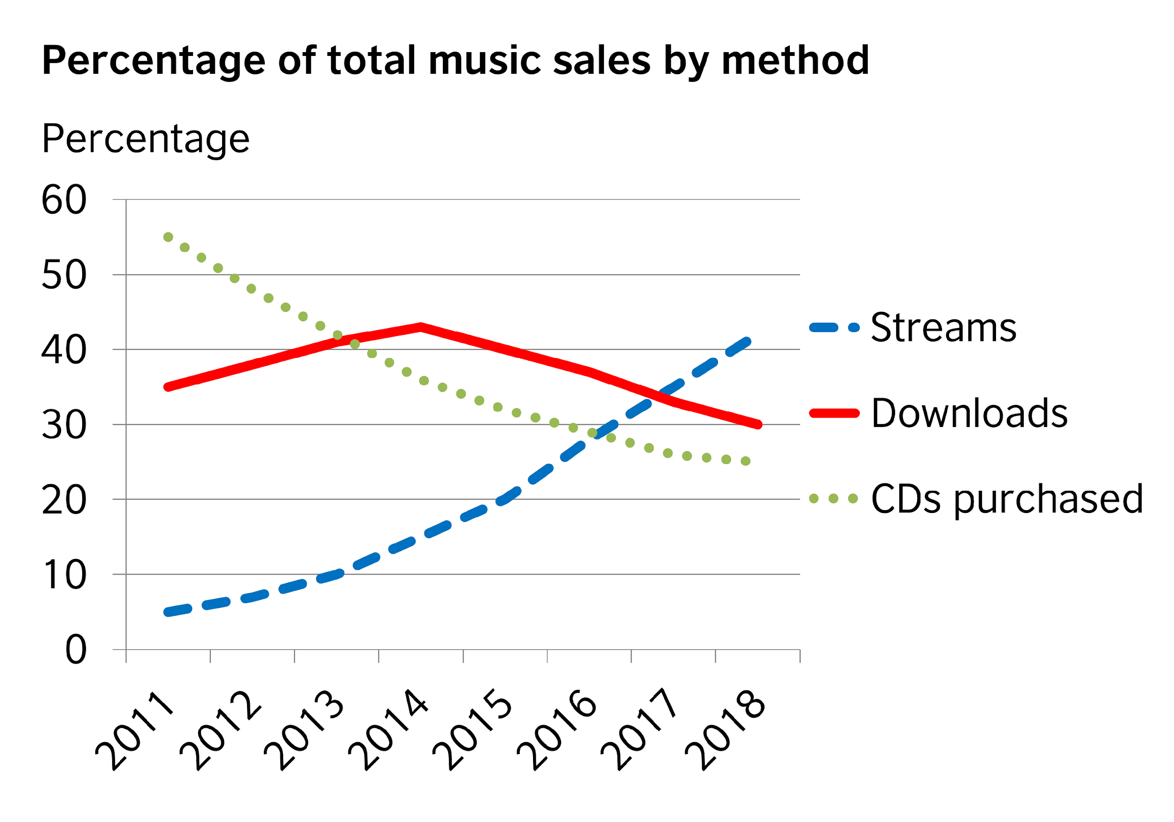
The graph below shows how people buy music. Put the verbs in italics in the correct form.
The graph …………….. illustrate trends in music buying habits between 2011 and 2018. It ……………present three different methods: streaming, downloading and buying CDs.
Overall, both downloads and physical sales of music …………………….…..decline/steadily. The latter ………………… slump since 2011, while the downturn for the former ……………. begin in 2014. However, there ………………… be a sharp rise in people streaming music since 2013.
In 2011, the majority of music sales ……. be of CDs, at 55% of all sales. In contrast, streaming was not common at all at only 5%. Also, although people ……………….start to download music, it only ……………..represent 35% of sales. As sales of CDs began to fall, downloads started to rise. They…………………….. rise/steadily and downloads overtook physical sales in mid-2013. During the same period, streaming………………… double to 10% but then it start …………… to grow more dramatically.
illustrates
presents
have steadily declined
has slumped
began
has been
were
had started
represented
rose steadily
doubled
started
13

Slide 15

A multiple line graph
14

Slide 16
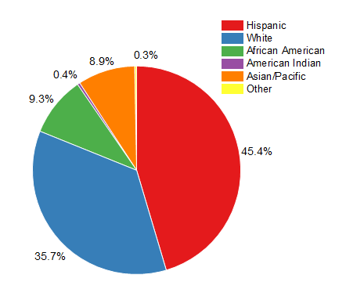
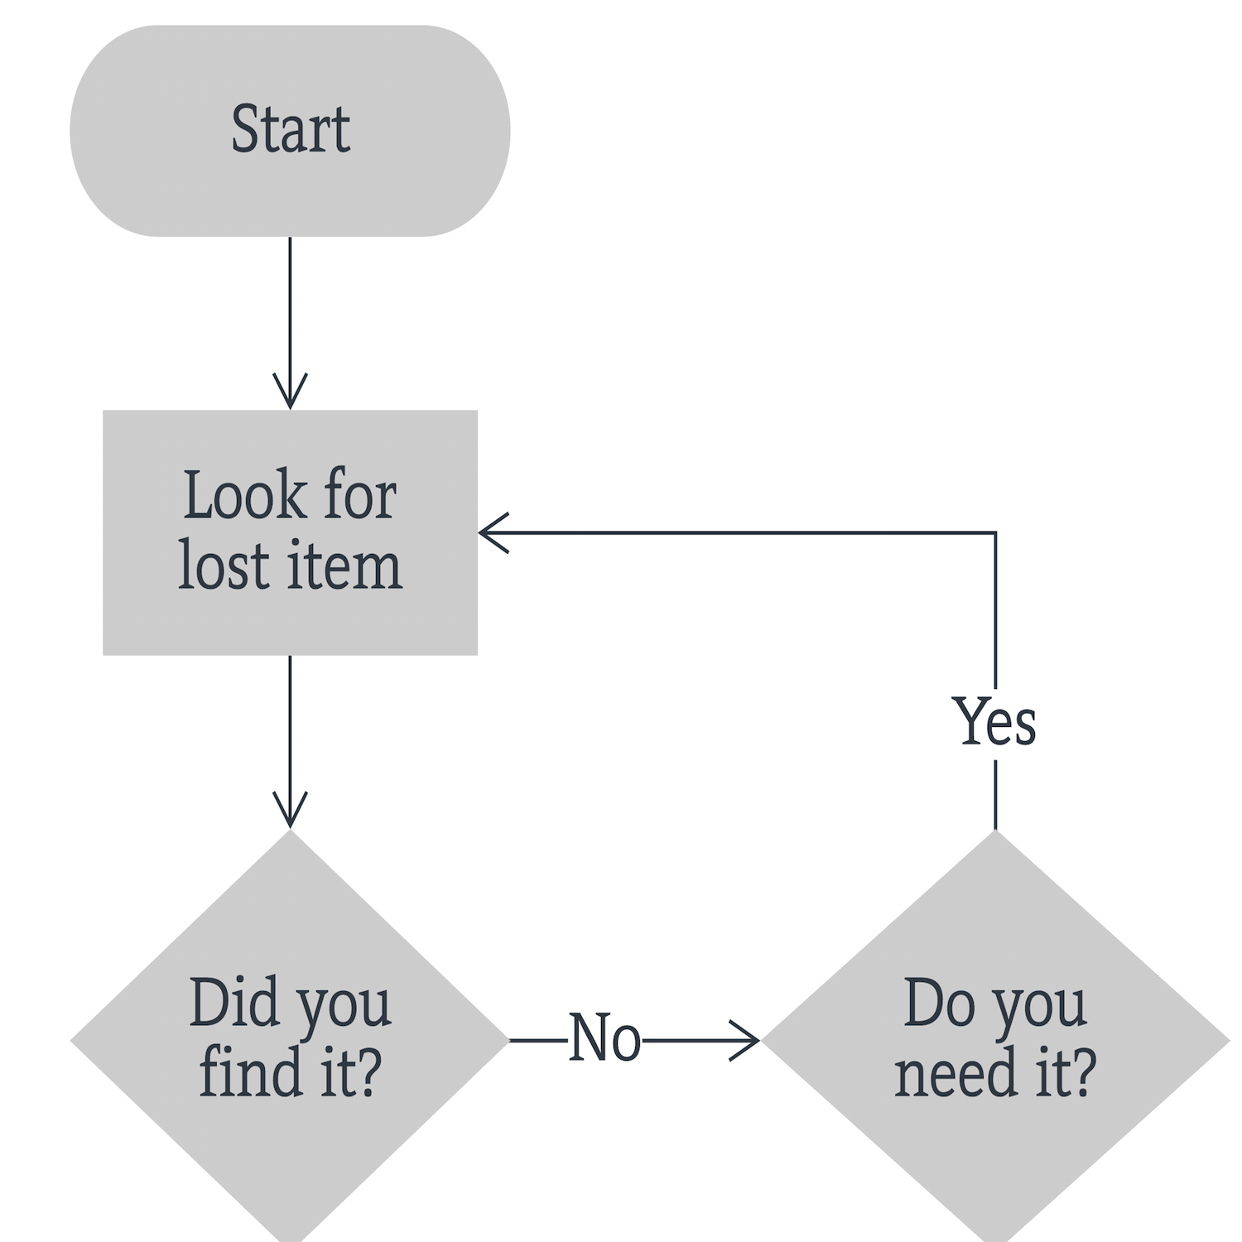
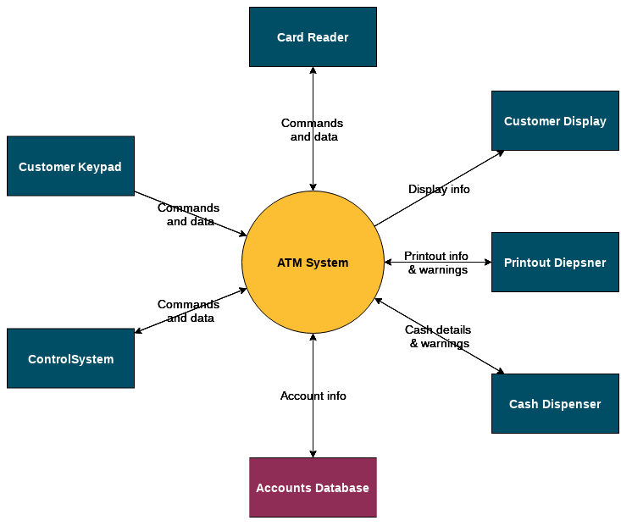
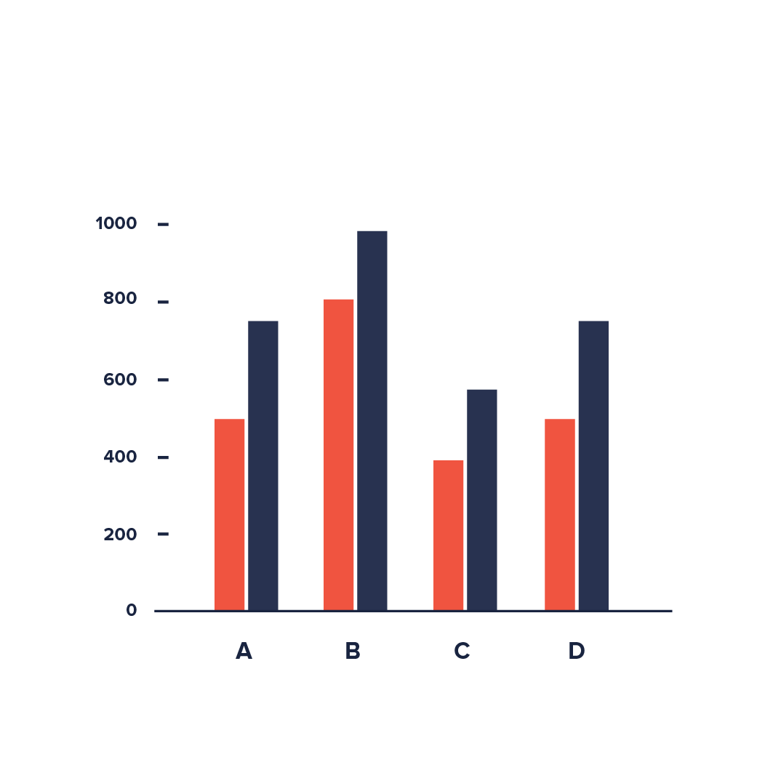
What do we call the following graphs
Pie Chart
Flow Chart
Diagram
Bar Chart
15

Slide 17

Trends
A trend shows development over a period of time.
We can describe trends in English in different ways.
1-Verbs of change
Demand for Blackberries has soared in recent years.
2-Prepositions
Sales rose by 20% over the holiday period.
3- Adjectives
4- Adverbs
16

Slide 18
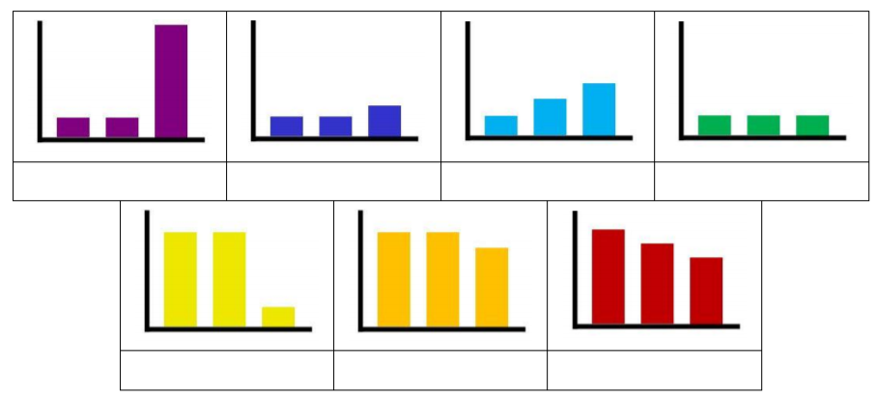
Match the descriptions to the bar charts.
a steady rise no change a slight fall a sharp rise
a steady fall a sharp fall a slight rise
a sharp rise
a slight rise
a steady rise
no change
a sharp fall
a slight fall
a steady fall
17

Slide 19

Passive
The passive is often used in notices, announcements and describing processes.
18

Slide 20


Compare the following sentences
Active
Passive
In the second sentence we are more interested in the tree: the object
The arborist cuts down the tree.
The tree is cut down.
Who cuts down the tree?
What is being cut down?
The arborist
The tree
What are we stressing on in the 1st sentence?
What are we stressing on in the 2nd sentence?
In the first sentence we are more interested in the arborist: the subject
20

Slide 21
We use the passive when we are not interested in who performs an action or it is not necessary to know.
Information about the takeover had been leaked to the press.
We often use it to describe processes and procedures because we are more interested in the process itself than who carries it out.
The bottles are filled before the labels are put on.
We use the passive to write in a formal style as it is less personal than the active. It is often used in reports, minutes and business correspondence.
Your application has been forwarded to the Human Resources Department.

Slide 22
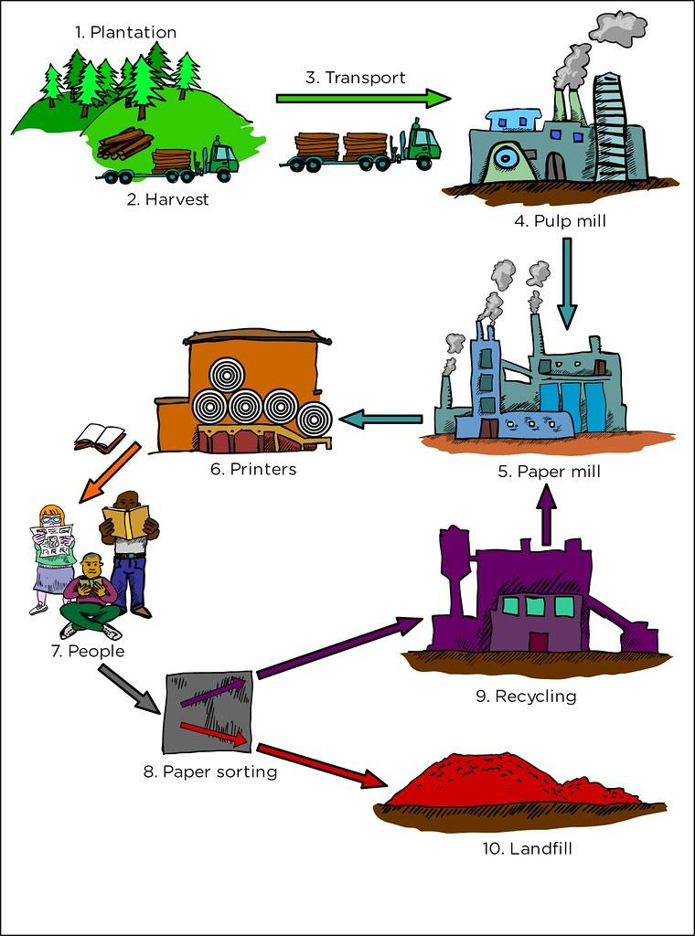
Form:
Passive : object + to be + past participle
Active : subject + verb
The tree is cut down.
The arborist cuts down the tree.
Describing a process needs the present simple
passive and active.
21

Slide 23
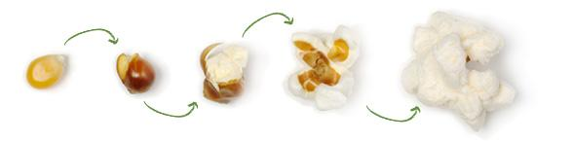

The paragraph below describes the process of making popcorn. Put the verbs in italics in the correct form. Note the use of sequencers to list the steps.
Now, Make Popcorn!
Popcorn is something you often eat when you watch a movie. It is easy to make popcorn if you follow the process below.
The first step is that three tablespoons of oil …………….put in a large pot. Next, the pot ……………place on the stove and the oil……………heat on a high flame. Subsequently, one kernel of popcorn……………..add. After this kernel pops, a quarter cup of popcorn………….put into the pot. The pot……………..cover with a lid. In the next stage, the flame…………. reduce and the pot …. gently…………. shake until the corn pops. Then, the pot……………..remove from the stove. Finally, the popcorn……………..empty into a large bowl, where melted butter and salt…………….add.
are put
is placed
is heated
is added
is put
is covered
is reduced
is
shaken
is removed
is emptied
are added
22

Slide 24
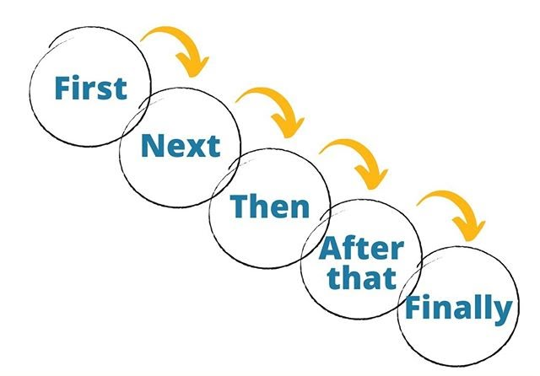
Time Sequencers
We use time sequencers to:
sew paragraphs together by connecting one idea to the other.
show when one stage finishes and the next one starts when describing a process.
Examples are: first, second, third, after that, then, later, next day, before, two minutes later, when, as soon as, once, subsequently, while, at the end, finally…
50

Slide 25
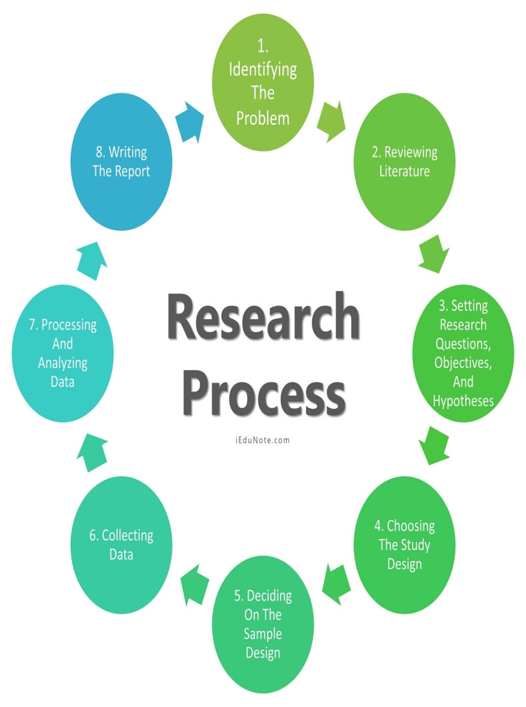
To begin with/First
Guess the appropriate time sequencers.
…………………..........., identify a research problem.
…………………. ,formulate the problem in terms of the specific aspects of the general area of your interest that has not been so far researched.
………….. discovering and defining the research problem, researchers should make a formal statement of the problem leading to research objectives.
The research design is the blueprint or framework for fulfilling objectives and answering research questions.
……………………. comes sampling , which is an important and separate step in the research process.
The gathering of data may range from simple observation to a large-scale survey in any defined population.
…………………. data are edited to ensure consistency across respondents and to locate omissions, if any.
The entire task of a research study is ……..…….. accumulated in a document called a proposal.
Then/Second
After/Once
25
Following this /Henceforth
Subsequently/Afterwards
finally/eventually/at last
51

Slide 26

Conditionals
Also called 'if clauses'. They describe the result of something that might happen (in the present or future) or might have happened but didn't (in the past)
23

Slide 27





If + ……….………+ ………….………
simple present simple present
If + ……………….+ …………………..
simple present simple future
If + …………… + …………………..
simple past would + base form
If + ………………. + ……… + …… + ……….
past perfect would have past participle
Complete the forms below and describe the use of each type.
To express things that are always true like a scientific fact.
To express a possible condition in the future.
To express that the outcome is less certain or is imaginary.
To express that a condition is unreal in the past.
24

Slide 28
Complete the Conditional sentences (Type I, II or III) by putting the verbs into the correct form.
hadn’t taken
If you ………………………(not/take) so long making a decision, we would have signed the contract.
If you had read the paper, you ……………………………. (see) the advertisement.
Unless you accept the agreement, we ………………(review/not) our terms.
If you provided us with some leverage, we…….. ………………. (reconsider) the deal.
Provided you increase your order by 10 %, we ……..…………. (give) you a discount.
would have seen
won’t review
would reconsider
will give
25

Slide 29
Choose the correct answer
If you liked it, ………….. you buy it?
a. will b. would c. can
Were you to fail, what ………….. ?
a. will you do b. would you do c. would you have done
If I'd been there, things…………. different now.
a. would be b. would have been c. Either could be used here.
If you had listened, you …………………. what she said.
a. would understand b. understood c. would have understood
If your computer ........................... , you will lose unsaved work.
a. crashes b. crashed c. had crashed
26

Slide 30

Mixed Conditional
When do we use it ?
The mixed conditional is used when we imagine a past change with a result in the present or a present change with a result in the past.

Slide 31
If I had met the new client, I would invite him to try our product.
hypothetical past
Present result
If her husband earned enough money, he would have bought her a car.
Past result
Imaginary present
31
Notes:
1 If we want to connect a hypothetical past with a present action or situation, the if clause follows the pattern of the 3rd conditional and the result clause follows the pattern of the 2nd conditional.
He didn’t meet the client and he the product is not tried.
2 If we want to connect a hypothetical present with a past action or situation, the if clause follows the pattern of a 2nd conditional and the result clause follows the pattern of a 3rd conditional.
He husband doesn’t earn enough money so he didn’t buy her a car.

Slide 32
Complete the Mixed Conditional sentences by putting the verbs into the correct form.
would have called
If I had more time, I _________________ (to call) you last night.
2. You wouldn't have this job if I _____________ (to prepare) you for the interview.
If you _____________ (to accept) that job, you would be miserable now.
If she _____________ (to take) his car without permission last night, she might be in trouble.
Their son would be untroubled if they _____________ (to stay) in the old neighborhood.
hadn’t prepared
had accepted
had taken
had stayed
25
Notes:
1-In this sentence, we are talking about a hypothetical condition happening in the present (second conditional) with a past result (third conditional). ➪ We use past in the if clause (second conditional) and would/could/might + have + past participle in the main clause (third conditional).
2. In this sentence, we are talking about a hypothetical condition happening in the past (third conditional) with a present result (second conditional). ➪ We use past perfect in the if clause (third conditional) and would/could/might + infinitive in the main clause (second conditional).
3. In this sentence, we are talking about a hypothetical condition happening in the past (third conditional) with a present result (second conditional). ➪ We use past perfect in the if clause (third conditional) and would/could/might + infinitive in the main clause (second conditional).
4. In this sentence, we are talking about a hypothetical condition happening in the past (third conditional) with a present result (second conditional). ➪ We use past perfect in the if clause (third conditional) and would/could/might + infinitive in the main clause (second conditional).
5. In this sentence, we are talking about a hypothetical condition happening in the past (third conditional) with a present result (second conditional). ➪ We use past perfect in the if clause (third conditional) and would/could/might + infinitive in the main clause (second conditional).

Slide 33
Try to make mixed sentences
1- The economy is bad and the speaker of the sentence did not go on vacation to Madrid.
1- We would have been able to go on vacation to Madrid this year if the economy weren’t so bad.
2- Kevin doesn’t speak good English, and he didn’t get the job.
2- If Kevin spoke good English, he might have gotten the job
3- Amanda took time off to raise her kids and she isn’t the CEO now.
3- If Amanda hadn’t taken time off to raise her kids, she might be the CEO now.

Slide 34
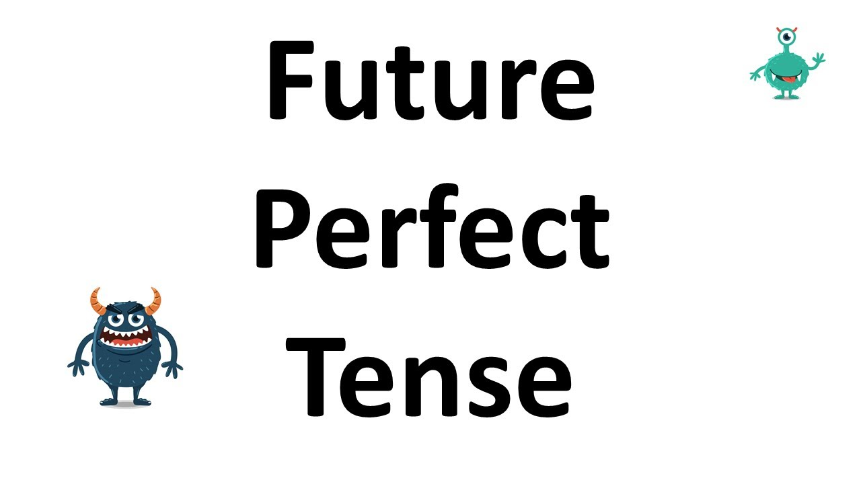
Future Perfect
USE: We use the future perfect to talk about the completion of an action at a specific time in the future.
FORM: Will have + past participle
27

Slide 35
Time expressions
By the end of the day/week/month..
By this time next month/year..
By three o’clock,
By then,
By July,
In four months,
All these expression mean at the end of a period of time in the future
25

Slide 36
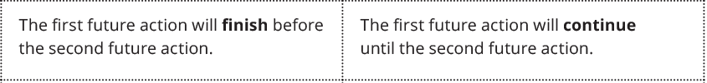
WHAT’S THE DIFFERENCE BETWEEN THESE TWO TENSES?
FUTURE PERFECT SIMPLE
FUTURE PERFECT CONTINUOUS
Finished action when the moment comes.
State and actions verbs.
Predictions focused on result.
Actions in progress when the moment comes.
Only actions verbs.
Predictions focused on the length of the action.

Slide 37
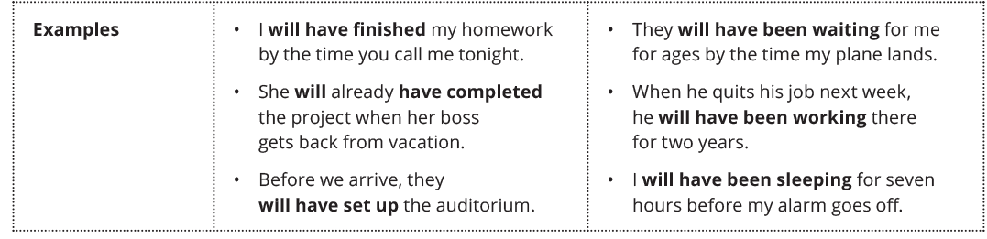
WHAT’S THE DIFFERENCE BETWEEN THESE TWO TENSES?
FUTURE PERFECT SIMPLE
FUTURE PERFECT CONTINUOUS

Slide 38
Put the verbs into the correct form (Future perfect simple or Future Perfect Continuous
He (listen) __________________________________ for the CEO for 2 hours.
He (not/finish) ______________________ building the roof by the end of the weekend.
By the end of this week, we (work) __________________________________ on the project for a month.
We (wait) ____________________________________________________________ for him for 14 days by next Tuesday.
Within a few days, they (find) _______________ a solution.
I (work) _______________________for 7 hours by 3 o'clock.
(You/completed ) _____________________ refurbishing the flat by next Friday?
will have been listening/'ll have been listening
will not/won’t have finished
will have been working/'ll have been working
will have been waiting for/'ll have been waiting for/shall have been waiting for
will have found
will/’ll have been working
Will you have completed

Slide 39

Indirect Questions
An embedded question is a question that is found inside another question or a statement.
A sentence with two clauses, the second clause contains a question.
27

Slide 40

Direct Questions VS Indirect Questions
Indirect questions are a little more formal and polite. We use them when talking to a person we don’t know very well, or in professional situations, and their form is a little different.
Example of an indirect question: “Could you tell me where the bathroom is?”
Direct questions are the “normal” questions that we can ask friends, family members, and people who we know well.
Example of a direct question: “Where is the bathroom?”

Slide 41
Rewrite the sentences without changing the meaning
1- What does she want?
Could you tell me what she wants?
2- Why is that little baby crying?
Do you know why that little baby is crying?
3- Is there any water here?
Do you know if there is any water here?
4- Is he coming tomorrow?
Could you tell me if he is coming tomorrow?
5- How many associates does she have?
Do you happen to know how many associates she has?
27

Slide 42
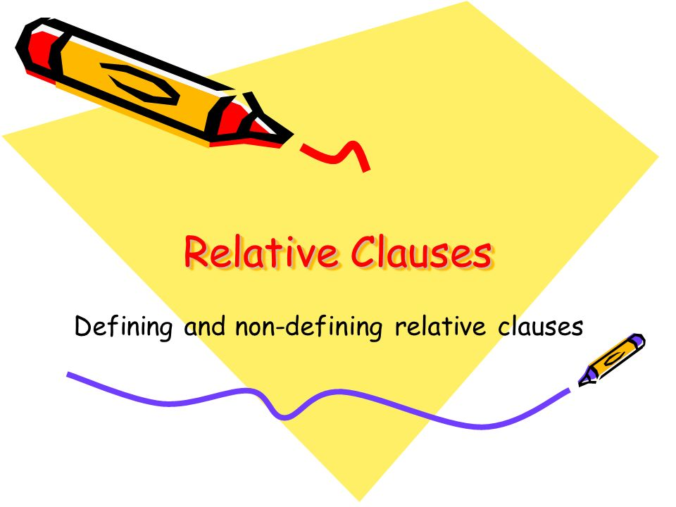
Relative Clauses
A relative clause is used:
to avoid repetition and combine sentences.
to give extra information about the nouns in the main clause, without starting a new sentence.
27

Slide 43
Relative clauses are divided into two types.
1
2
Defining RC
Non-defining RC
28

Slide 44

Defining RC
Non-defining RC
Identify or classify nouns.
Tell us which person/thing is meant
E.g. Are you the one who sent me the email?
Describe the person/thing identified and provides extra information
E.g. The award was given to Sara, whose short story impressed the judges.
29

Slide 45
The relative pronouns are:
WHO/ THAT subject pronoun for People
WHICH/ THAT subject or object pronoun for People/Things
WHOM (or WHO) object pronoun for People
WHERE refers to Place
WHEN refers to Time
WHOSE refers to Possession for Humans and non Humans (animals and things)
30

Slide 46
Complete the relative clauses using an appropriate relative pronoun.
I sent an email to my brother, ………….. lives in Australia.
The company called a lawyer…………firm is known for such cases.
They broke the computer ……………. belongs to the company.
They started their business in a remote city, ……….they think there is little competition.
The idea behind the advertising campaign was inspired from a previous era ……………… women did not use to have freedom of expression.
An advertising campaign is a specifically designed strategy ……….. is carried out across different medium.
who
whose
which/that
where
when
that
31

Slide 47

Idioms
An idiom is a phrase, saying or a group of words that has a metaphorical (not literal) meaning.
You may know the meaning of individual words, but not the overall meaning when they are put together in a particular way.
32

Slide 48





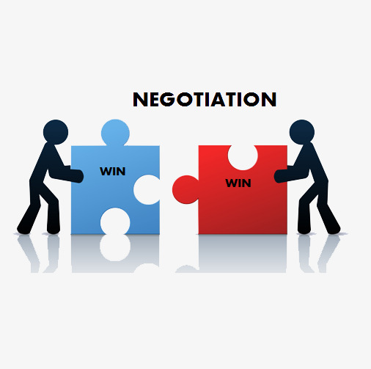
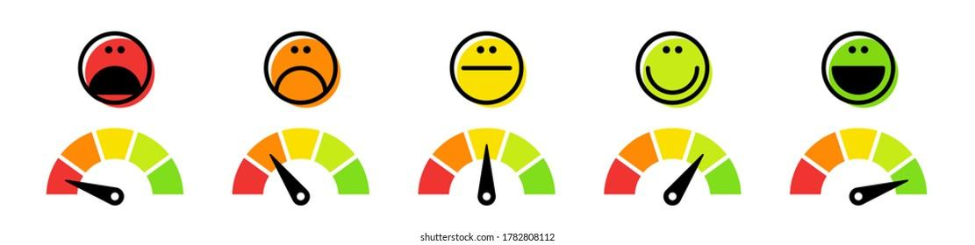
Notes:
negotiation

Slide 49

CHOOSE THE CORRECT OPTION AND GIVE AN EXAMPLE
People heard about the book by word of mouth, so the publisher
a. didn't have to spend much on marketing
b. had to spend a lot on marketing
c. had to sell it at a lower price
The best possible marketing tool is word of mouth, but a product has to be extremely good to earn it.

Slide 50
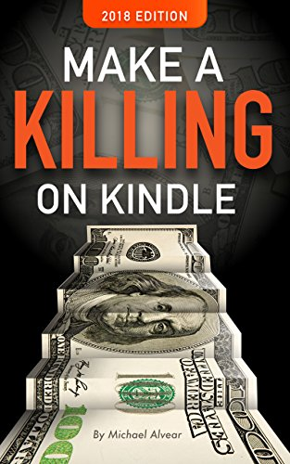
CHOOSE THE CORRECT OPTION AND GIVE AN EXAMPLE
After James made a killing on the stock exchange, he
a. did his time in jail
b. recovered in a hospital
c. celebrated in a nightclub
Lots of people made a killing when property values went so high back in the nineties.

Slide 51

CHOOSE THE CORRECT OPTION AND GIVE AN EXAMPLE
To be on the crest of a wave
a. to be at the same level
b. to be at the top level of achievements
c. to have low self-esteem
The baseball team is riding the crest of a wave after their last win.

Slide 52

CHOOSE THE CORRECT OPTION AND GIVE AN EXAMPLE
Sail through something
a. Being successful in doing something without difficulty
b. Works very well or has the desired effect
c. Clever or expert way of doing something
Thanks for your help, we could sail through that grassy slope.

Slide 53
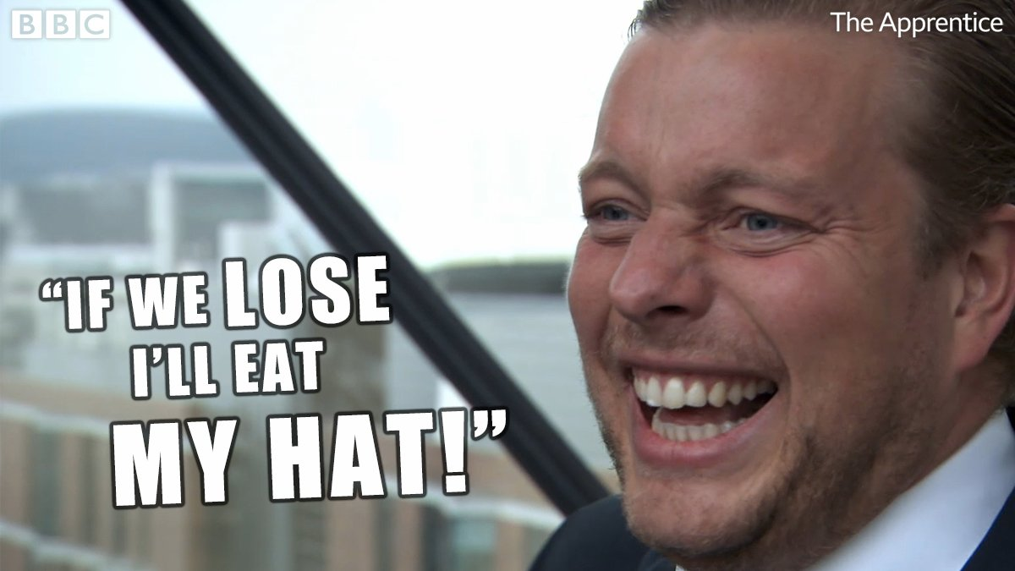
To eat one’s hat:
a. to be sure something will happen
b. to be hesitant something will not happen
I'll eat my hat if you get a raise.

Slide 54

Riding high
a. to behave in an arrogant way
b. to be very happy & excited
c. to be raised high off the ground
He was riding high because of his daughter’s recent success in the business.

Slide 55
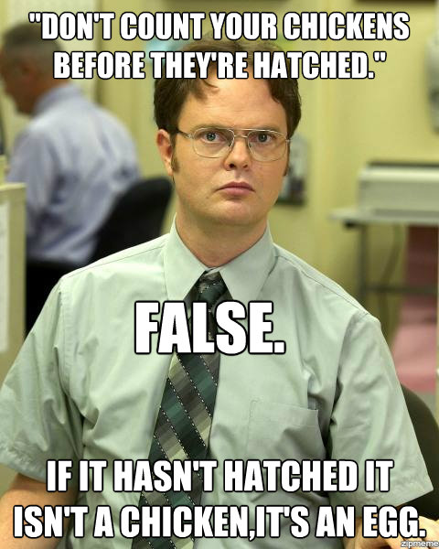
Do not count your chickens before they hatch:
a. do not share your secrets
b. do not make plans that depend on something good happening before you know that it has actually happened
Before committing to make the payment, wait till you receive the money from the bank. Don't count your chickens before they hatch.

Slide 56
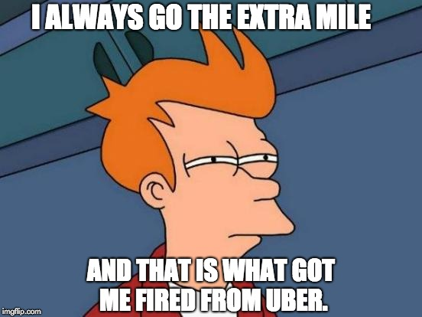
Go the extra mile:
a. you are willing to make a special effort to achieve something.
b. you walk a bit more although you are tired just to prove that you can.
The President is determined to go the extra mile for peace.

Slide 57
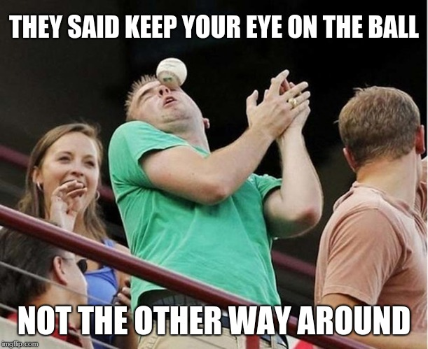
To keep your eye on the ball:
a. to pay close attention to what you are doing
b. to hold something firmly out of fear
I graduated in just three years because I was able to keep my eye on the ball and prioritize my studies above all else.

Slide 58

Email Writing
Formal vs informal emails
45

Slide 59
Study the following rules for writing effective emails. Decide which ones you think are most important:
1. Be concise and to the point. Avoid long emails that are discouraging to read.
2. Try to reply to your customers’ emails within 24 hours.
3. Do not write in CAPITALS - it seems like you are shouting and you might get a flame mail in response.
4. Leave the message thread in your email to save the recipient time and frustration looking for earlier messages.
5. Add disclaimers to your emails to protect you and your company from liability.
6. Proof-read your email before you send it.
7. Only copy in other people if they know why they are receiving a copy of the message.
8. Do not overuse abbreviations and emoticons - the recipient might not know what they mean.
9. Do not request read receipts - this will annoy your recipient.
10. Do not reply to spam - this will generate even more spam.

Slide 60

Quiz time

Slide 61

61
Choose the correct answer
1. Dear Mr. Smith, we are sorry to ………………. that...
a-say you
b-let you know
c- inform you
d-explain you
2. Thank you for bringing this …………………to my attention.
a-thing
b-matter
c-stuff
d-items
3. I am extremely……………… the service I received...
a-dissatisfied with
b-dissatisfied from
c-crossed about
d-crossed for
4. Hi John, how's it going? …………………….. my holiday in Spain.
a-I am writing to give you some details regarding...
b-I intend to describe...
c-I want to tell you about...
d-I'd like to say you...
🗹
🗹
🗹
🗹

Slide 62
62
Choose the correct answer
5. As you will see from my CV, I have ……………………. experience in this area.
a-masses of
b-a considerable amount of
c-loads of
d-great
6. That's all for now. See you tonight! …………. _, Mary xxxx
a-Yours faithfully
b-Yours sincerely
c-Best wish
d-Love
7. If you did not know the recipient's name, how would you close the email?
a-With love. c-Yours faithfully.
b-Yours sincerely. d-Affectionately yours.
8. What would you say in the opening part of a formal email?
a-Ask how good the weather is in the recipient's city.
b-Talk about how good the weather is in your city.
c-Ask the recipient if he is hale and hearty.
d-Inform the recipient why you are writing the email.
🗹
🗹
🗹
🗹

Slide 63
63
Choose the correct answer
9. If you did not know the recipient's name, how would you address the person?
a-Dear Mr./Mrs.
b-Dear Sir or Dear Madam.
c-My dear.
d-Hello.
10. In an informal email, you should do what?
a-Scribble.
b-Ignore grammar.
c-Leave out the date.
d-Write legibly in simple English.
11. In order to have the desired effect on the recipient, what should a formal email be?
a- In the proper format
b-To the point and relevant
c- Grammatically correct
d-All the above
🗹
🗹
🗹

Slide 64

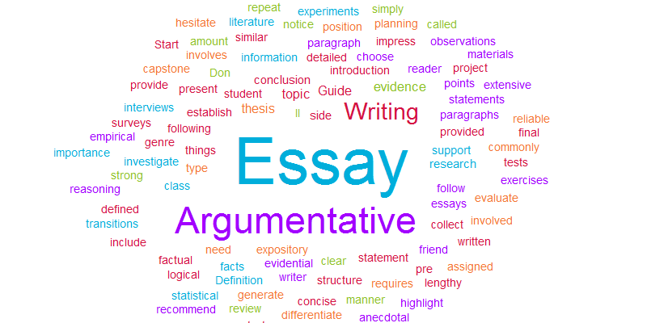
WRITING

Slide 65
Argumentative Essay
A a piece of writing that takes a stance on an issue.
The writer attempts to persuade readers to understand and support their point of view about a topic by stating their reasoning and providing evidence to back it up.

Slide 66




The writer outlines the topic, provides background information necessary to understand the arguments, outlines the evidence that will be presented and states the thesis.
It is a concise, one-sentence summary of your main point and claim.
Body paragraphs are where you back up your claims with examples, research, statistics, studies and text citations.
Each body paragraph should cover a different idea or piece of evidence and contain a topic sentence that clearly and concisely explains why the reader should agree with your position.
Address opposing points of view and disprove them or explain why you disagree with them.
It restates your thesis & summarizes all of the arguments made in your body paragraphs.
47

Slide 67

Let us assess what you have just reviewed!

Slide 68
The main purpose of an argumentative essay is .. a. To persuade your audience into believing your side of the argument. b. To argue over a certain topic without considering the other side viewpoints c. To argue about a topic until your opponent gets angry and leaves
✔
67

Slide 69
How many parts is an argumentative essay made of .. a. 2 b. 3 c. 4 d. 5
✔
67

Slide 70
The introductory paragraph of an essay requires: a. The topic, thesis, and main ideas b. The topic, thesis, and supporting details c. The reason for the essay, the topic, and thesis
✔
67

Slide 71
What is the information that supports the writer's reasoning? a. topic b. claim c. conclusion d. evidence
✔
68

Slide 72
The conclusion of an argumentative essay should: a. include new facts & more arguments. b. have a restatement of the thesis and summarizes the arguments c. never use a personal anecdote explaining how the topic personally affects the writer
✔
69
Notes:
NO

Slide 73
Which option below is an example of a thesis? a. Deforestation is detrimental to our environment because species are losing their habitats, climate change, and fewer forests. b. Deforestation can be good and bad for the environment. c. Does deforestation hurt the environment?
✔
72

Slide 74
The smooth, logical flow of sentences within a paragraph is called... a. Paragraph deduction b. Paragraph coherence c. Paragraph personality
✔
74

Slide 75
……………..are the clue words for sequencing .. a. Hence, Therefore, etc. b. First, Next, Then, Finally, etc. c. Main idea, Details, etc.
✔
74

Slide 76
the order of the sentences in a body paragraph should be .. a. Evidence, explanation and topic sentence. b. Explanation, evidence and topic sentence c. Topic sentence, evidence, explanation. d. Explanation, topic sentence ,evidence
✔
74

Slide 77
Nonetheless is a linking word to... a. List an argument b. Add more points c. Contrast
✔
74

Slide 78
Which transition signals a conclusion? a. In short b. In addition c. Henceforth
✔
75

Slide 79

PRACTICE

Slide 80
By the end of 2050, sales …………………… However, in 2051, they ………………. a. will drop/ will recover b. will drop/ will have recovered c. will have dropped /will recover
✔
54

Slide 81
In 2007, the cost of an average house in the UK ……………….. £130,000. However, the price ……………… to almost £190,000 by 2008. a. were/have risen b. was/has risen c. was/had risen
✔
55

Slide 82
Which type of graph would be the most useful to show changes in a quantity over time. a. Line graph b. Pie chart c. Bar graph
✔
56

Slide 83
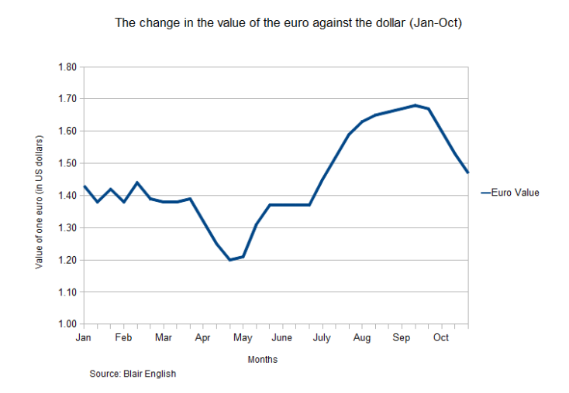
Throughout the month of June, the value of the euro ______________ at a value of $1.37.
a. recovered steadily
b. stabilized steadily
c. remained constant
✔
57

Slide 84
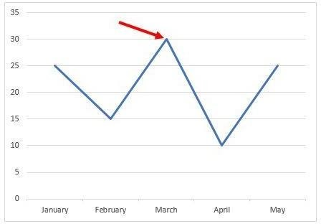
The number of visitors ……. 30,000 in March. a. leveled off at b. dipped to c. peaked at
✔
58

Slide 85
Traders .................. £10,000 in revenue since the traffic scheme was implemented. a. had lost b. lost c. have lost
✔
59

Slide 86
To start primary fermentation, ......................... to the pulp. a. they may either add yeast b. yeast may either be added c. you should add yeast
✔
60

Slide 87
The cocoa comes from the cacao tree. Once the pods are ripe and red, they …………… and the white cocoa beans ………………. Following a period of fermentation, they …………….. on a large tray so they can dry under the sun. Next, they …………….. into large sacks and …………. to the factory. a. are harvested/ are removed/ are laid out/ are placed/ delivered b. are being harvest/ are being removed/ are laid out/ are placed/ are delivered c. have been harvested/ had been removed/ were laid out/ were placed/ were delivered
✔
61

Slide 88
If I …………..… for a newly washed and pressed uniform to be left in your office every morning, …………..… it instead of your own business clothes? a. arranged/ will you wear b. arranged/ would you wear c. will arrange/ will you wear
✔
62

Slide 89
………………………………….. the latest iPhone if your company ………………………………….a refurbished one? a. Would you have bought/ hadn’t provided b. Would you bought/ hadn’t provided c. Will you buy/ has provided
✔
63

Slide 90
If the brand had been committed to ethical marketing, it ....... in trouble. a. would not have been b. would not had been c. would not be
✔
64

Slide 91
During our last meeting, the sales manager said: “Unless we reduce prices, we…………………. to defeat our rivals on the marketplace. a. would not be able b. would not have been able c. will not be able
✔
65

Slide 92


Good luck

Slide 93


Slide 94

ANY QUESTIONS

